Slide 1
Data Structure
Programming Project #5
郭建志

Slide 2
Image
You want to count elements
You don’t need exact results

Slide 3
Problem
Given:
keys in many documents
Goal:
Count the key frequency
Bounded error is allowed
Constraint:
Limited storage and limited computation

Slide 4
Simple Solution
Construct a map from elements to counts
Balanced binary tree: map in C++
Hash table: unordered_map in C++
You may want to use libraries Guava or FastUtil in Java for convenience and better performance

Slide 5
Problem
The number of of distinct elements might be very large
You have a limited memory space
For real-time applications you need runtime guarantees

Slide 6
Solution: Count-Min Sketch
The trick: don’t store the distinct elements, but just the counters
Create an integer array of length x initially filled with 0s
Each incoming element gets mapped to a number between 0 and x
The corresponding counter in the array gets incremented
To query an element’s count, simply return the integer value at it’s position

Slide 7
Solution: Count-Min Sketch
The trick: don’t store the distinct elements, but just the counters
Create an integer array of length x initially filled with 0s
Each incoming element gets mapped to a number between 0 and x
The corresponding counter in the array gets incremented
To query an element’s count, simply return the integer value at it’s position
You are completely right: There will be collisions!

Slide 8
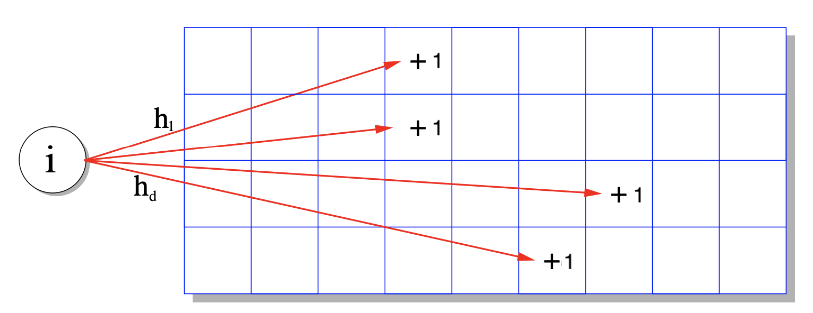
Solution: Count-Min Sketch
Use multiple arrays with different hash functions to compute the index
When queried, return the minimum of the numbers the array

Slide 9
Solution: Count-Min Sketch
Use multiple arrays with different hash functions to compute the index
When queried, return the minimum of the numbers the array
You are completely right: There will still be collisions!

Slide 10
Solution: Count-Min Sketch
Use multiple arrays with different hash functions to compute the index
When queried, return the minimum of the numbers the array
You are completely right: There will still be collisions!
… but less

Slide 11
Some properties
Only over-estimates, never under-estimates the true count
Has a constant memory and time consumption independent of the number of elements
The relative error may be high for low-frequent elements

Slide 12
To be practical: Conservative Update
Instead of incrementing every counter, only increment the ones which need an update
Experiments show a strong error reduction using this heuristic

Slide 13
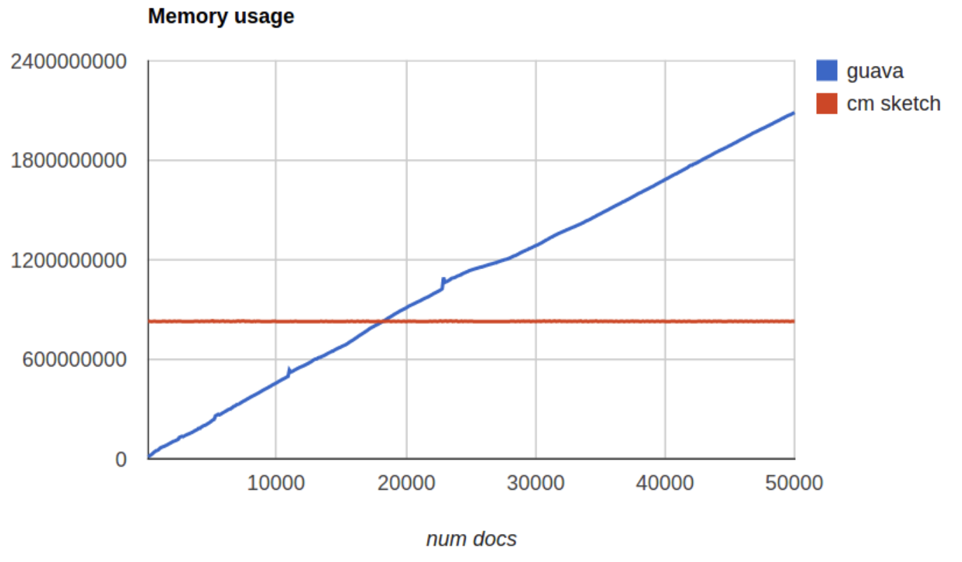
Comparison

Slide 14
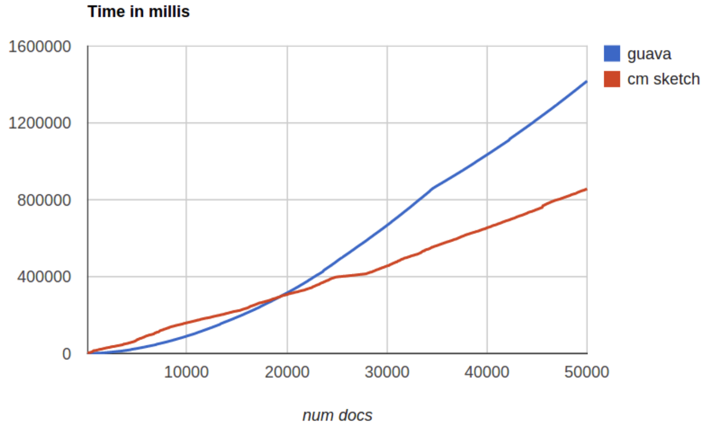
Comparison

Slide 15
Usage
General:
Every counting problem on large data sets, where errors are acceptable
Counting elements in data streams (e.g., trend detection on Twitter, Facebook, and news)

Slide 16
Usage
Mine:
Feature selection for large sets using pointwise mutual information (PMI)
PMI has been used for finding associations between words
All kinds of feature statistics like word co-occurrences

Slide 17
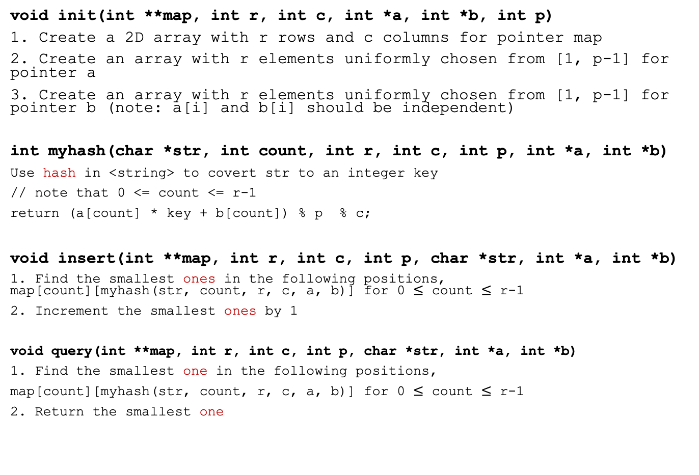
You need to implement:
void init(int **map, int r, int c, int *a, int *b, int p)
1. Create a 2D array with r rows and c columns for pointer map
2. Create an array with r elements uniformly chosen from [1, p-1] for pointer a
3. Create an array with r elements uniformly chosen from [1, p-1] for pointer b (note: a[i] and b[i] should be independent)
int myhash(char *str, int count, int r, int c, int p, int *a, int *b)
Use hash in <string> to covert str to an integer key
// note that 0 <= count <= r-1
return (a[count] * key + b[count]) % p % c;
void insert(int **map, int r, int c, int p, char *str, int *a, int *b)
1. Find the smallest ones in the following positions, map[count][myhash(str, count, r, c, a, b)] for 0 $≤$ count $≤$ r-1
2. Increment the smallest ones by 1
void query(int **map, int r, int c, int p, char *str, int *a, int *b)
1. Find the smallest one in the following positions,
map[count][myhash(str, count, r, c, a, b)] for 0 $≤$ count $≤$ r-1
2. Return the smallest one

Slide 18
Input Sample: input.txt
10 10 1019
Data structures serve as the basis for abstract data type. The abstract data type defines the logical form of the data type. The data structure implements the physical form of the data type.
#rows #cols prime
Text…
Note: your code should understand that ”Data” is equivalent to “data” and ignore punctuation marks (e.g., commas)

Slide 19
You don’t need to output anything, but..
Command:
# data
6
# serve
1
# type
4
Input a key
Return a value
Note: The value is allowed to have a small error to some extent, since you are using cm sketch instead of binary search tree

Slide 20
Note
Deadline: 1/3 Thu (有問題可以再調整)
This project accounts for 15% of the total score
You are not allowed to use ”class” in STL to count the words
You must implement a 2D array with the given size (i.e., #rows and #cols in input.txt) to count the words
E-course
C or C++ Source code
You can read this paper if you are interested in the research field:
http://dimacs.rutgers.edu/~graham/pubs/papers/cmsoft.pdf

